Slide 1
Our Core Team Discussion guide
Notes:
NOTES
Our Core was developed to build a collective understanding of Who We Are as a company.
Allow us all to embrace the same purpose, vision, mission, values and behaviors.
Create a world-class customer service.
Strengthen who we are and how we work.

Slide 2
Work session agenda
Cultural Transformation
How We Got Here
Introducing: Our Core
Purpose, Vision & Mission
Values
Behaviors
Group Activity
Q&A
Notes:
NOTES
Our Core is part of Pratt & Whitney’s culture transformation.
There is a group exercise on slide 11 that will help you implement the new behaviors on a daily basis.

Slide 3
A Cultural Transformation
Pratt & Whitney is undergoing a cultural transformation
Employees must understand who we are and how we work with our customers, suppliers and each other
Consistent, transparent and timely communication is vital to this transformation
“As leaders, we’re responsible for engaging the hearts and minds of our people to give them a higher sense of purpose.”
-Bob Leduc
Notes:
NOTES
Our company has faced challenges in connecting the dots of Who We Are.
We want to create a culture that gives every employee a sense of purpose and fulfillment in their work.
Be sure every employee understands the company’s purpose and the role they play in bringing that purpose to life.

Slide 4
How we got here
Pillars of Success introduced in 2017
To guide employee behaviors
Confusion created between the Pillars and local values and philosophies
“Our Core” introduced in 2019
Simplifies Who We Are by combining Our Values (formerly Pillars of Success) with our Purpose, Vision, Mission & Behaviors
Notes:
NOTES
Pillars of Success = our Values.
Values combined with Purpose, Vision, Mission and Behaviors = Our Core.

Slide 5
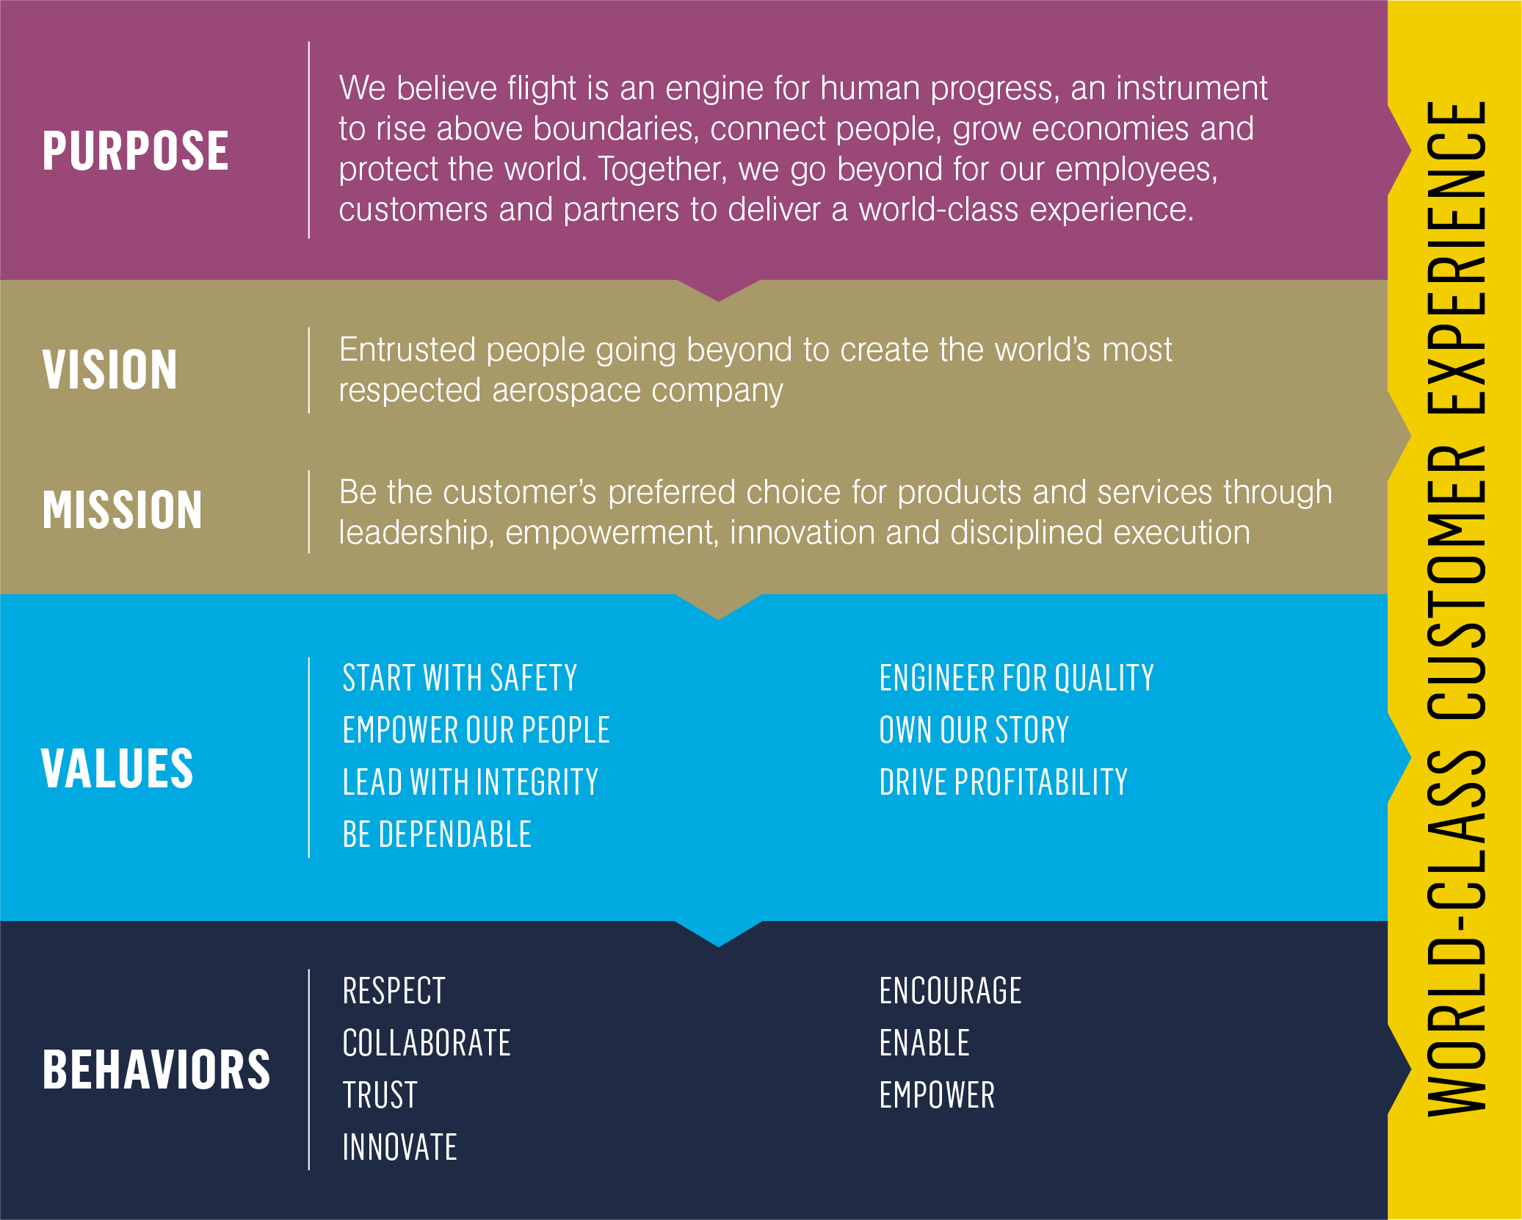
Our core
Who we are and how we work
Gives clarity and simplicity to our company’s shared belief system
Provides the foundation for how we create the safest and most dependable products for our customers
Vital to achieving our vision of becoming the world’s most respected aerospace company
Notes:
NOTES
New value was added as part of Our Core: Start with Safety.
There is nothing more important than the safety of our people and products.

Slide 6
Purpose
We believe flight is an engine for human progress, an instrument to rise above boundaries, connect people, grow economies and protect the world. Together, we go beyond for our employees, customers and partners to deliver a world-class experience.
vision
Entrusted people going beyond to create the world’s most respected aerospace company
mission
Be the customer’s preferred choice for products and services through leadership, empowerment, innovation and disciplined execution
Notes:
NOTES
A company’s purpose is its reason for existing.
A vision is what we want to become as a company.
A mission statement is what we do to accomplish our purpose.

Slide 7
VALUES
Start with safety
Look out for yourself and others. Follow safe working procedures. Recognize and report hazards. Focus on the task; when in doubt just stop.
Empower our people
Build an inspiring employee experience. Focus on engagement. Instill a sense of ownership.
Lead with integrity
Stay committed to compliance. Be trustworthy and transparent.
Be dependable
Deliver on commitments. Be accountable. Create the future with innovative products.
Notes:
NOTES
Our Values are the fundamental beliefs of our company.
Saw these previously as the Pillars of Success.
Start with Safety: important new value. Nothing is more important that the safety of our employees.
Empower our People: having employees take ownership of their work gives them a sense of purpose and belonging.
Lead with Integrity: always do the right thing, be transparent and stay committed to compliance issues.
Be Dependable: deliver on promises to our coworkers and our customers; hold ourselves accountable.

Slide 8
VALUES
Engineer for quality
Build strength from within. Instill quality and safety in what we make and how we work.
Own our story
Strengthen our brand. Share our global story. Be Pratt & Whitney ambassadors.
Drive profitability
Prioritize resources. Drive decision making. Apply metrics. Treat it like your own business.
Notes:
NOTES
Engineer for Quality: ensure that our engines are perfect and our processes to create them are as effective, efficient and safe as they can be.
Own Our Story: tell it in new ways; share story with the broader company.
Drive Profitability: treat our work like we own the business.

Slide 9
BEHAVIORS
RESPECT
Lead by example. Communicate openly and honestly. Earn and show appreciation.
COLLABORATE
Support each other. Be inclusive of others’ opinions. Speak for each other.
TRUST
Be authentic. Listen first. Take ownership of outcomes.
innovate
Think outside boundaries. Take and reward smart risks. Be curious and promote a learning culture.
Notes:
NOTES
Our behaviors are guided by our values.
We bring our Values to life on a daily basis and support our culture transformation.
Respect: challenge each other, but do it respectfully.
Collaborate: we accomplish our mission by working together.
Trust: take ownership of your outcomes.
Innovate: requires continuous learning.

Slide 10
BEHAVIORS
encourage
Assume positive intent. Start with empathy. Develop and coach each other.
enable
Establish meaningful relationships. Be part of the solution. Break down barriers.
EMPOWER
Set clear expectations and delegate. Be open to different options. Take initiative and share progress.
Notes:
NOTES
Encourage: build each other up.
Enable: break down barriers.
Empower: ask-is it legal? Is it good for my customer? Am I willing to be held accountable for it?

Slide 11
Bringing the behaviors to life
Optional Group Activity
Think about the behavior you’ve been assigned and what it means to you.
Take a few minutes to write down specific examples of how you currently exhibit that behavior or could in the future.
Share your best examples with the group.
Notes:
NOTES
This activity will help employees better understand the new Behaviors and how they bring them to life.
Suggested instructions for this activity are below but feel free to adjust to the size of your group.
Break employees into groups of 2-3 people. If you have a smaller group, assign each employee their own behavior(s).
Assign one Behavior to each group and ask each group to spend 2-3 minutes thinking of specific examples of ways they currently exhibit that Behavior or could in the future.
When done, come back together and ask each group to share their examples.

Slide 12
WHAT’S NEXT?
LEARN
Today is about getting to know Our Core and understanding the Behaviors that will bring this all to life. You’ll continue to hear more about them in the future.
ADOPT
Moving forward, we hope that employees make a conscious effort to adopt these behaviors in their daily routine, embracing the Values that make up who we are.
LIVE
As these Values and Behaviors become a stronger part of how we work day-in and day-out, we’ll continue to build ways to measure and recognize them.
Notes:
NOTES
Our Core will let Pratt & Whitney deliver on our Purpose to Go Beyond for our employees, customers and partners.

Slide 13
Questions or feedback?

